Slide 1


Demographic Data Practicum
Tri-Service Hearing Technician
4.2 Certification Course

Slide 2
Demographic Data Practicum
Learning Objectives
2.2.1 Enter demographic data correctly
2.2.2 Understand that previous drop down selections limit future drop down choices
2.2.3 Practice entering demographic data
2.2.4 Right click to assist with drop down window choices
2.2.5 Patients not tested within DOEHRS-HC
Tri-Service Hearing Technician 4.2 Certification Course

Slide 3
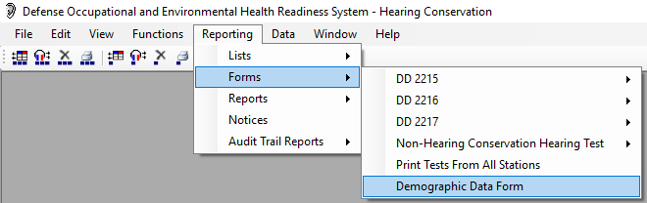
Demographic Data Practicum
Demographic Data Form
Tri-Service Hearing Technician 4.2 Certification Course
Notes:
Form to be filled out by patients prior to coming to the booth for testing

Slide 4
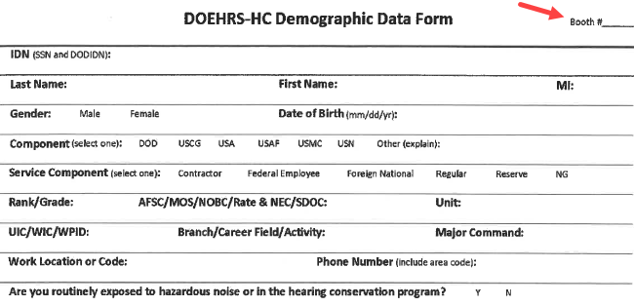
Demographic Data Practicum
Required Patient Demographic Information
Tri-Service Hearing Technician 4.2 Certification Course
Notes:
Ensure patient Demographic Data Form is filled out with enough information to verify/input patient in DOEHRS-HC
Annotate station number within booth to ensure patient data matches the patient you are testing
SSN is the primary key and is required to be correct

Slide 5
Demographic Data Practicum
Patient Data Entry
Have the patient fill out a demographic form
This form assists inputting patient data correctly
Ensure the form has enough information so that patient data entry can be completed in DOEHRS-HC
If more information is required, question the patient prior to placing them in the booth
Write the station number on the patients demographic sheet on multi-stationed booths
Tri-Service Hearing Technician 4.2 Certification Course

Slide 6
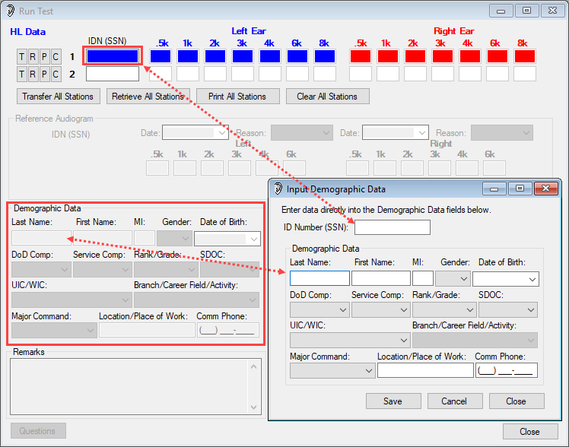
Demographic Data Practicum
DOEHRS-HC Run Test/Input Demographic Data Windows
Notes:
For training purposes we are going to enter Demographic Data only without testing patients. The Input Demographic Data window mimics the same fields in the Run Test Demographic Data section. Unlike the Run Test screen, data can be either edited and/or saved in the Input Demographic Data screen without test retrieval. This is just to get you used to entering patient data that can be saved without testing patients.

Slide 7
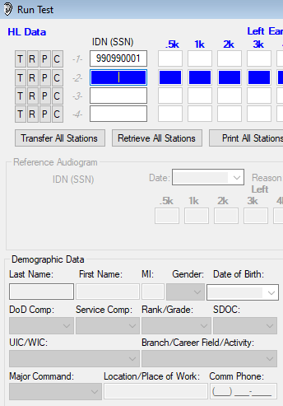
Demographic Data Practicum
DOEHRS-HC Demographic Data Entry
Enter Patient SSN (normally done in the run test window)
Use tab to move forward to next field
Enter date for DOB M/D/YY, tab
Use hot keys
Location - only free text area available for local use
Ensure to enter a valid current phone number for the patient
Tri-Service Hearing Technician 4.2 Certification Course

Slide 8
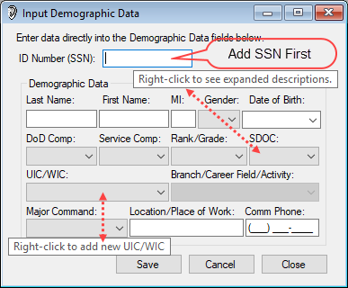
Demographic Data Practicum
DOEHRS-HC Demographic Data Entry
For training purposes go to Functions>Input Demographic Data window
Enter your SSN
Use tab to move forward to next field
Enter date for DOB M/D/YY, tab
Use hot keys
Right click to add UIC into local database
Location - only free text area available for local use; Specific Work Location
Tri-Service Hearing Technician 4.2 Certification Course
Notes:
Go to Functions>Demographic Input
Have students enter/save demographic data for themselves; right click to add UIC; raise their hands when done to ensure their UIC was properly entered
Hot Keys = keyboard shortcuts
Any questions request assistance from facilitators

Slide 9
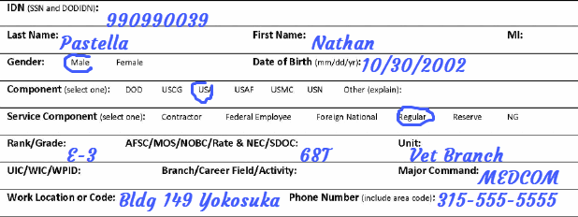
Demographic Data Practicum
Patient Data Entry
Add demographic data for 990990039, Nathan Pastella
Tri-Service Hearing Technician 4.2 Certification Course
Notes:
Do not move on to the next slide until all students have completed this practicum.
Easiest way to find UIC is Under Unit>Text Filters>Custom Filter enter Yokosuka then DoD drop down select USA

Slide 10
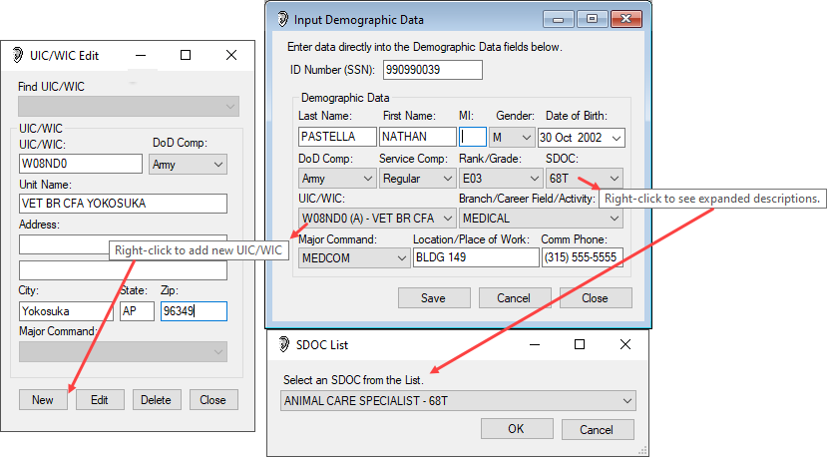
Demographic Data Practicum
Learning Objectives
Right Click to select MOS via expanded description and to add the UIC
Find UIC: Under Unit>Text Filters>Custom Filter enter Yokosuka then DoD drop down select USA
Notes:
Review and have students edit/save demographic data (in the edit demographic window) if incorrect.
Easiest way to find UIC is Under Unit>Text Filters>Custom Filter enter Yokosuka then DoD drop down select USA

Slide 11
Demographic Data Practicum
Patient Data Entry
Enter patient demographic data in the Run Test screen when a patient is present for testing
This data in conjunction with the threshold levels retrieved from the CCA-200 window will save as an audiogram (record)
Enter demographic data correctly and completely (use Tab)
Incomplete data entry may restrict test data from being retrieved from the CCA-200 window
Tri-Service Hearing Technician 4.2 Certification Course

Slide 12
Demographic Data Practicum
General Information
Patient SSN is a primary key, it has to be entered correctly
Never use “Other” as a DoD comp without an audiologist prior approval
Dependents, non-DoD employees and children age 16 or younger will not be entered into DOEHRS-HC
Tri-Service Hearing Technician 4.2 Certification Course

Slide 13
Demographic Data Practicum
Summary
Enter demographic data
Previous drop down selections limit future drop down choices
Right click in fields to have drop down window assistance
Patients that will not be tested within DOEHRS-HC
Sometime today fill out the DOEHRS-HC Demographic Data Form in the back of your training booklet; for training purposes all students are in the hearing conservation program
Tri-Service Hearing Technician 4.2.0.0 Certification Course

Slide 14
Demographic Data Practicum
? Questions ?
Tri-Service Hearing Technician
4.2 Certification Course

